Slide 1
Advanced Data mining
Tek Narayan Adhikari

Slide 2
Advance Data Mining
Subject Code: MDS 602
Course Title: Advanced Data Mining
Nature: Theory+ Practical ( Compulsory)
Total Teaching hours : 48 Hrs
Objective of Course
Understand concept like pre-processing, measure of similarity, Summary statistics and visualization.
Understand and implementation of different algorithms for association, classification, clustering and anomaly detection

Slide 3
Evaluation System
40% internal evaluation and 60% external exam.
Internal exams are based on: Attendance/Assignment work / Oral test / Class test / Presentation / Class seminar / Project work/ Term exam
External exam : By School in permission of exam board of TU.
Note:
Student must secure at least 50 % on both semester Exam and Internal Assessment individually.

Slide 4
Syllabus
Unit 1: Introduction
Introduction to data mining, Origins of data mining, Data mining tasks, Types of data, Data quality, Data pre-processing, Measure of similarities and dissimilarity, summary statistics and visualization.
Unit 2: Association Analysis
Basic concepts, Apriori Algorithm, Pattern-growth approach, Handling categorical and continuous attributes, handling concept hierarchy, sequential and subgraph patterns
Unit 3: Classification
Decision tree induction, Rule-based classifier, nearest-neighbor classifier, Bayesian classifier, artificial neural network (ANN), Support vector machines, ensemble methods, model evaluation and selection.

Slide 5
Syllabus
Unit 4: Clustering
Overviews; K-means algorithm, hierarchical clustering, DBSCAN, Fuzzy clustering, Graph based clustering, clustering evaluation.
Unit 5: Outlier detection
Preliminaries, outliers and types, statistical approaches, proximity based approaches, clustering based approaches, classification based approaches.
Laboratory works: Implementation of each algorithm in python/ weka tool.

Slide 6
What is Data Mining?
“The process of discovering meaningful patterns and trends often previously unknown by using some mathematical algorithm on huge amount of stored data”
“Extraction of interesting, non-trivial, implicit, previously unknown and potentially useful information or patterns from data in large database.”
Data mining is basically concerned with the analysis of data and the use of software techniques for finding patterns and regularities in sets of data.

Slide 7
Two Approaches are:
Descriptive Data Mining
Predictive Data Mining

Slide 8
Descriptive Data Mining:
It characterizes the general properties of data in the database.
It finds patterns in data the user determinants which ones are important.
Mostly used during data exploration.
Typical questions answered by descriptive data mining are:
What is in the data?
What doesn’t look like?
Are there any unusual patterns?
What does the data suggest for customer segmentation?
User may have no idea on which kind of patterns are interesting?
Functionalities of descriptive data mining are: Clustering, Summarization, Visualization, and Association.

Slide 9
Predictive Data Mining:
X: Vectors of independent variables.
Y: Dependent variables
Y = f(X)
Users don’t care about the model, they simply interested in accuracy of predictions.
Using unknown examples the model is trained and the unknown function is learned from data.
The more data with known outcomes is available the better is the predictive power of model.
X
Model
Y

Slide 10
Predictive Data Mining:
Used to predict outcomes whose inputs are known but the output values are not realized yet.
Never 100% accurate.
The performance of a model on past data is not predicting the known outcomes.
Suitable for unknown data set.
Typical questions answered by predictive models are:
Who is likely to respond to next product?
Which customers are likely to leave in the next six months?

Slide 11
Data Mining Process:
Problem Definition
Data Gathering & Preparation
Model Building & Evaluation
Knowledge Deployment
Problem Definition:
Focuses on Understanding the project objectives and requirements in terms of business perspective.
Eg: How can I sell more of my product to customer? Which customers are most likely to purchase the product?
Data Gathering and Preparation:
Data Collection & Exploration.
Identify data quality, patterns in data.
Data preparation phase covers all the tasks involved to build the model.
Data preparation tasks are likely to be performed multiple and not in any prescribed order.

Slide 12
Data Mining Process cont..
Model Building and Evaluation:
Various modeling techniques are applied and calibrated the parameters to optimal values.
Evaluate how well the model satisfies the originally stated business goal.
Knowledge Deployment:
Use data mining within a target environment.
Insight and actionable information can be derived from data.

Slide 13
Why Data Mining?
Data mining is a combination of multidisciplinary field. It can be applied in many fields and can be done using many algorithm and techniques.
Database
Technology
Statistics
Machine
Learning
Data Mining
Visualization
Pattern
Recognition
Other
Disciplines
Algorithm

Slide 14
Data Mining Vs. Query Tools
SQL can find normal queries from the database such as what is an average turnover? Whereas data mining tools find interesting patterns and facts such as what are the important trends in sells?
Data mining is much more faster than SQL in trend and pattern analysis since it uses algorithm like machine learning, genetic algorithm.
If we know exactly what we are looking for, we use SQL nut if we know only vaguely what we are looking for we use data mining.
Hybrid information can’t be easily be traced using SQL.

Slide 15
Data Warehouse
In most of the organization, there occur large databases in operation for normal daily transactions called operational database.
A data warehouse is a large database built from the operational database.
In computing, a data warehouse (DW or DWH), also known as an enterprise data warehouse (EDW), is a system used for reporting and data analysis, and is considered a core component of business intelligence. DWs are central repositories of integrated data from one or more disparate sources.

Slide 16
Data Warehouse
A data warehouse is a database, which is kept separate from the organization's operational database.
There is no frequent updating done in a data warehouse.
It possesses consolidated historical data, which helps the organization to analyze its business.
A data warehouse helps executives to organize, understand, and use their data to take strategic decisions.
Data warehouse systems help in the integration of diversity of application systems.
A data warehouse system helps in consolidated historical data analysis.

Slide 17
Data Warehouse
A data warehouse should be:
Time – dependent
There must be a connection between the information in the warehouse and the time when it was entered.
One of the most important aspect of the warehouse as it relates to data mining, because information can then be sourced according to period.
Non-Volatile
Data in a warehouse is never updated, but used only for queries.
End-users who want to update data must use operational database.
A data warehouse will always be filled with historical data.

Slide 18
A data warehouse should be:
Subject Oriented
Not all the information in the operational database is useful for a data warehouse.
A data warehouse should be designed especially for decision support and expert system with specific related data.
Integrated
In an operational data, many types of information being used with different names for same entity.
In a data warehouse, all entities should be integrated and consistent i.e. only one name must exist to describe each individual entity.

Slide 19
Data Warehouse
Data
Information
Decision
Query Manager
Operational Data
Load manager
Detailed Information
Summary
Information
External Data
Meta Data
Warehouse Manager
Fig: “Architecture of a Data Warehouse”

Slide 20
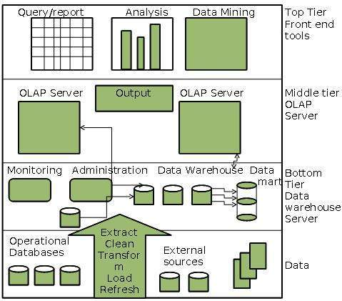
Three Tire Architecture of Data Warehouse

Slide 21
Data Warehouse
Load Manager: The system components that perform all the operations necessary to support the extract and load process. It fast loads the extracted data into a temporary data store and performs simple transformations into a structure similar to the one in the data warehouse.
Warehouse Manager: Performs all the necessary operations to support the warehouse management process. It analyzes the data to perform consistency and referential checks. It also transforms and merges the source data in the temporary data store into the published data warehouse with creating indexes and business views. Update all existing aggregations and back up data in the data warehouse.
Query Manager: Performs all the operations necessary to support the query management process by directing queries to the appropriate tables. In some cases it also stores query profiles to allow the warehouse manager to determine which indexes and aggregations are appropriate.

Slide 22
Data Warehouse
Detailed Information: Stores all the detailed information to determine the business requirements to analyze the level at which to retain detailed information in the data warehouse.
Summary Information: Stores all the predefined aggregations generated by the warehouse manager. It is a transient area which will change on an ongoing basis in order to respond to changing query profiles. It is essentially a replication to detailed information.
Meta Data: Meta data is data about data which describes how information is structured within a data warehouse. It maps data stores to common view of information with the data warehouse.

Slide 23
Data Warehouse Models
From the perspective of data warehouse architecture, we have the following data warehouse models:
Virtual Warehouse
Data mart
Enterprise Warehouse

Slide 24
Virtual Warehouse
The view over an operational data warehouse is known as a virtual warehouse.
A virtual data warehouse provides a compact view of the data inventory.
It contains Meta data.
It uses middleware to build connections to different data sources.
They can be fast as they allow users to filter the most important pieces of data from different legacy applications.
Easy to build a virtual warehouse.
Building a virtual warehouse requires excess capacity on operational database servers.

Slide 25
Data Mart:
Data Mart is a subset of the information content of a data warehouse that is stored in its own database.
Data mart may or may not be sourced from an enterprise data warehouse i.e. it could have been directly populated from source data.
Data mart can improve query performance simply by reducing the volume of data that needs to be scanned to satisfy the query.
Data marts are created along functional level to reduce the likelihood of queries requiring data outside the mart.
Data marts may help in multiple queries or tools to access data by creating their own internal database structures.
Eg: Departmental Store, Banking System.

Slide 26
Enterprise Warehouse
An enterprise warehouse collects all the information and the subjects spanning an entire organization
It provides us enterprise-wide data integration.
The data is integrated from operational systems and external information providers.
This information can vary from a few gigabytes to hundreds of gigabytes, terabytes or beyond.

Slide 27
Data Warehousing - Schemas
Schema is a logical description of the entire database.
It includes the name and description of records of all record types including all associated data-items and aggregates.
Much like a database, a data warehouse also requires to maintain a schema.
A database uses relational model, while a data warehouse uses Star, Snowflake, and Fact Constellation schema.

Slide 28
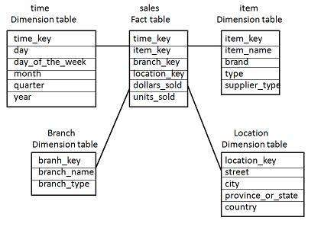
Star Schema
Each dimension in a star schema is represented with only one-dimension table.
This dimension table contains the set of attributes.
The following diagram shows the sales data of a company with respect to the four dimensions, namely time, item, branch, and location.

Slide 29
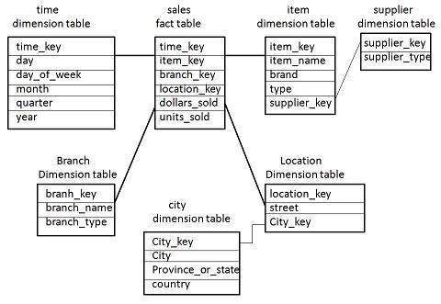
Snowflake Schema
Some dimension tables in the Snowflake schema are normalized.
The normalization splits up the data into additional tables.
Unlike Star schema, the dimensions table in a snowflake schema are normalized. For example, the item dimension table in star schema is normalized and split into two dimension tables, namely item and supplier table.

Slide 30
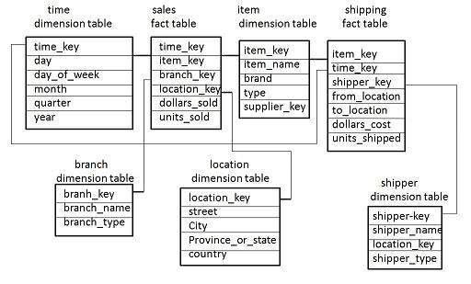
Fact Constellation Schema
A fact constellation has multiple fact tables. It is also known as galaxy schema.
The following diagram shows two fact tables, namely sales and shipping.

Slide 31
What is KDD?
Knowledge Discovery in Databases, or KDD for short, refers to the broad process of finding knowledge in data, and emphasizes the "high-level" application of particular data mining methods.
It is of interest to researchers in machine learning, pattern recognition, databases, statistics, artificial intelligence, knowledge acquisition for expert systems, and data visualization.
The unifying goal of the KDD process is to extract knowledge from data in the context of large databases.
It does this by using data mining methods (algorithms) to extract (identify) knowledge, according to the specifications of measures and thresholds, using a database along with any required pre-processing, subsampling, and transformations of that database.

Slide 32
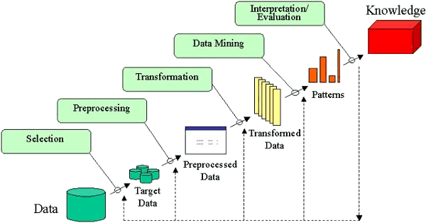
KDD Process
Developing an understanding of
the application domain
the relevant prior knowledge
the goals of the end-user
Creating a target data set: selecting a data set, or focusing on a subset of variables, or data samples, on which discovery is to be performed.

Slide 33
KDD Process
Data cleaning and pre-processing.
Removal of noise or outliers.
Collecting necessary information to model or account for noise.
Strategies for handling missing data fields.
Accounting for time sequence information and known changes.
Data reduction and projection.
Finding useful features to represent the data depending on the goal of the task.
Using dimensionality reduction or transformation methods to reduce the effective number of variables under consideration or to find invariant representations for the data.
Choosing the data mining task.
Deciding whether the goal of the KDD process is classification, regression, clustering, etc.

Slide 34
KDD Process
Choosing the data mining algorithm(s).
Selecting method(s) to be used for searching for patterns in the data.
Deciding which models and parameters may be appropriate.
Matching a particular data mining method with the overall criteria of the KDD process.
Data mining.
Searching for patterns of interest in a particular representational form or a set of such representations as classification rules or trees, regression, clustering, and so forth.
Interpreting mined patterns.
Consolidating discovered knowledge.

